Slide 1
CSE101-Lec#1
Computer Organization

Slide 2
OUTLINE
In this lecture we will study:
Computer Organization
Evolution of Operating Systems

Slide 3
What is a Computer?
Computer
Device capable of performing computations and making logical decisions (hardware)
Computers process data under the control of sets of instructions called computer programs (software)
Hardware
Various devices comprising a computer, such as central processing unit (CPU), memory, motherboard and hard disks as well as peripheral devices (keyboard, screen, mouse CD-ROM)
Software
Programs that run on a computer

Slide 4
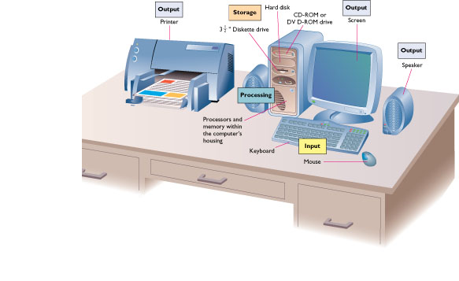
What is a Computer?

Slide 5
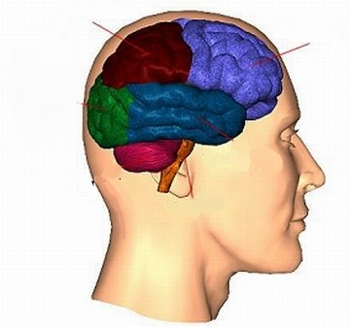
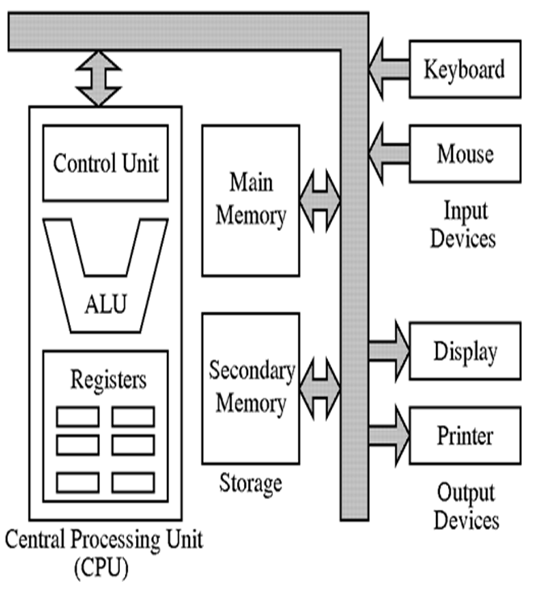
Computer Organization
CPU
Primary storage
Six logical units of Computer
Input Unit
Output Unit
Memory Unit (Primary Memory)
Arithmetic and
Logic Unit
CPU
Secondary Storage
Unit
Input
unit
Output
unit

Slide 6


Computer Organization
Input unit
“Receiving” section.
Obtains information (data and programs) from input devices
Input devices are: Keyboard, mouse, microphone, scanner, networks, etc
Quick yak:
Discuss some of the examples on input like mouth, ear, eyes and ask for more such examples…

Slide 7
Computer Organization
Output unit
“Shipping” section
Takes information processed by computer.
Places information on output devices.
Output devices are:
Screen, printer, speaker, etc.
Used information to control other devices.
Quick yak:
Discuss some of the examples on output like vocal chord etc. ask for more such examples…

Slide 8
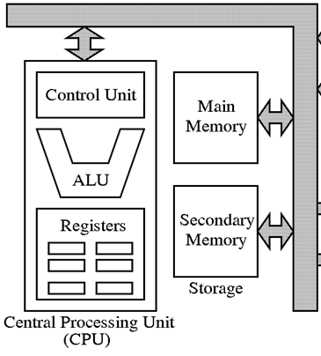
Computer Organization
Memory unit
Rapid access, relatively low capacity “warehouse” section
Retains information from input unit
Immediately available for processing
Retains processed information
Until placed on output devices
Information is Volatile
Called as memory or primary memory
Arithmetic and logic unit (ALU)
“Manufacturing” section
Performs arithmetic calculations and logic decisions

Slide 9
Computer Organization
Central processing unit (CPU)
“Administrative” section
Supervises and coordinates other sections of computer
Multiprocessors
Computers having multiple CPU’s
Multi-core processors
Implements multiprocessing on a single chip

Slide 10
Computer Organization
Secondary storage unit
Long-term, high-capacity “warehouse” section
Storage
Programs , data , information …...
Secondary storage devices
Disks, DVD’s, CD’s, Flash drives,….
Information is persistent (Non-volatile)
Longer to access than primary memory.
Less expensive per unit than primary memory.
Quick yak:
Secondary storage can be illustrated by examples on
Books
Note books
Telephone book etc.

Slide 11
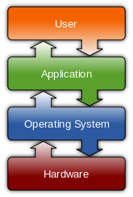
Operating System
Operating systems
A collection of programs that manages
resources of a computer, such as
- processors
- memory
- input/output devices
Perform basic tasks
Manage transitions between jobs
Increased throughput
Amount of work computers process
Multiprogramming
Many jobs or tasks sharing a computer’s resources
“Simultaneous” operation of many jobs.
Timesharing
Perform a small portion of one user’s job then moves on to service the next user

Slide 12
Batch Processing systems
First computer used batch OS in which computer ran batches of jobs without stop.
A 'batch' is the name given to the task of doing the same job over and over again
Programs were punched into card that were copied to tape for processing.
OS runs the series of jobs sequentially without user intervention.
When computer finished one job it would immediately start next one on tape.

Slide 13
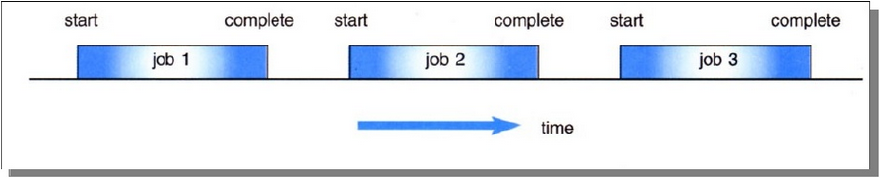
Batch Operating Systems
Jobs, together with input data, are fed into the system in a batch.
The jobs are then run one after another.
No job can be started until previous job is completed

Slide 14
The Advantages of batch based systems:
Significant savings
Reproducibility / elimination of human error
Lack of interaction between the user and job.
Inconvenient for users as users not interacted with machine. Only professional operator used this for stream.
CPU is often idle, because the speeds of the mechanical I/O devices is slower than CPU.
The Disadvantages of batch based systems

Slide 15
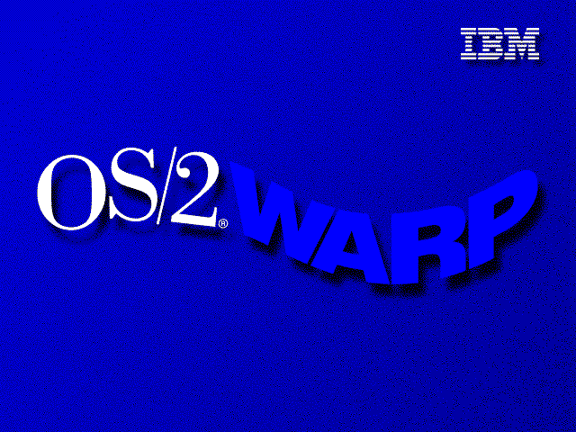
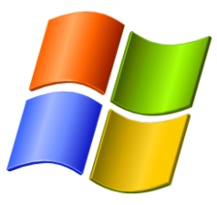

Examples of batch operating system are as follows: 1) DOS (Disk operating system) 2) IBM OS/2 3) Windows 1,2,3 95, 98 and ME

Slide 16
Time sharing Operating Systems
In 1960’s time shared replaced batch OS.
It allows many users to share the computer resources simultaneously.
Each user is given a time slice to interact with the CPU.
The size of the time slice will depend on the system.
Each user is served in sequence.

Slide 17
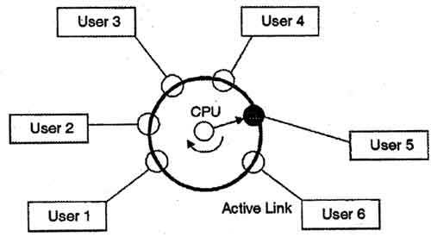
Example

Slide 18
Advantages of Timesharing operating systems
Provide advantage of quick response.
Reduces CPU idle time.
Disadvantages of Timesharing operating systems
Problem of reliability.
Question of security and integrity of user programs and data.
Problem of data communication.

Slide 19
Generations of Operating System
Operating systems have evolved through a number of distinct phases or generations :
First Generation
Second Generation
Third Generation
Fourth Generation
Fifth Generation

Slide 20
Generation | Duration | Memory Device | Features | Example
First (No operating system) | 1942-1955 | Vacuum Tubes or Valves | used vacuum tubes as electronic circuit magnetic drum for primary storage punch-card used as secondary storage machine level programming used operating speed was used in terms of millisecond | Mark-I, UNIVAC, ENIAC etc.
Second (First operating system started) | 1955-1964 | Transistor | magnet core memory used as internal storage magnet tapes used as secondary storage little bit faster I/O devices high level language used as programming processing speed measured in microsecond Beginning of batch processing systems | IBM 701, IMB 1401, ICL 2950/10 etc.
Third | 1964-1975 | IC(Integrated circuits) | semi-conductor memory used as primary storage magnetic discs were used as secondary storage massive use of high level language processing speed increased to nanosecond and even faster Concept of multiprogramming introduced Increased CPU utilization | IBM 360 series, UNIVAC 9000 etc.

Slide 21
Fourth | 1975-1990 | VLSI or Microprocessor | massive use of magnetic and optical storage devices with capacity more than 100 GB advancement in software and high level language operation speed increased beyond picoseconds and MIPS (Millions of Instructions Per Second) | IBM PC, Pentium PC, Apple/Macintosh etc.
Fifth | 1990+ to current state of the art | Bio-Chips | Artificial intelligence will make computer Intelligent and knowledge based very high speed, PROLOG (programming language) Concept of virtual machines introduced

Slide 22
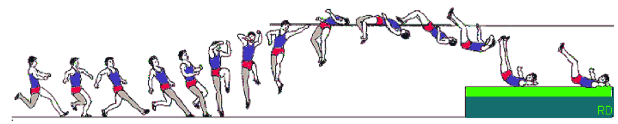
Procedural Programming
Involves procedures which are sequence of statements
The design method used in procedural programming is called Top Down Design. This is where you start with a problem and then systematically break the problem down into sub problems.
Traditional programming languages were procedural.
–C, Pascal, COBOL , etc
Quick yak:
Discuss about some of the PROCEDURAL daily routines, ask students to build examples….

Slide 23
Next Class: Programming Basics C Program development environment & tools
cse101@lpu.co.in

